Slide 1


Car Purchase Decision
Harry Hayfron-Benjamin

Slide 2

Problem Statement
My problem statement is “ How can we get more customers to purchase vehicles as a dealership?”
I chose to focus on this issue because I’m a car lover and I want to know what makes people make the decision to buy
This is going to benefit car dealerships and help them focus on the right demographic to tailor their marketing strategies to

Slide 3

Introduction
I’ve always been curious about what makes people buy cars. Buying a car is not a simple decision to make. Most of the time it’s stressful and for many other reasons which are sometimes in our control or not in our control.
I just analyzed a dataset that showed whether an individual purchased or did not purchase a car.

Slide 4
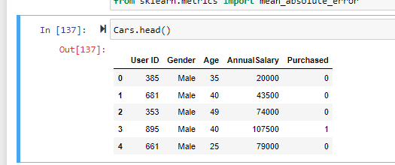
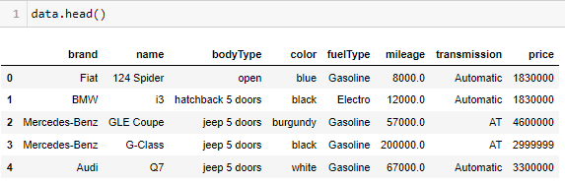
Methodology
I imported various libraries for my data visualization such as seaborn, matplot.pyplot. In the dataset it had User Id, gender, age, annual salary and purchased. I had two datasets one called cars and the other I called data. I did some data cleaning for the second dataset “data”. My initial thought was to find who is buying more based on these categories.
Gender
Age
Annual Salary

Slide 5

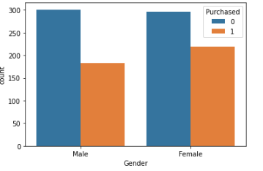


Findings and Insights

Slide 6
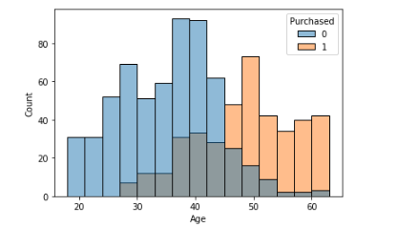
Findings and insights

Slide 7
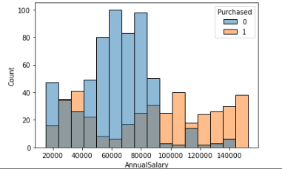
Findings and insights

Slide 8
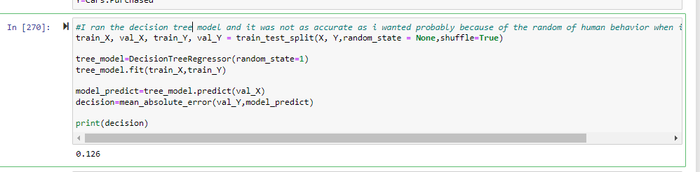
ML Models
Decision Tree

Slide 9
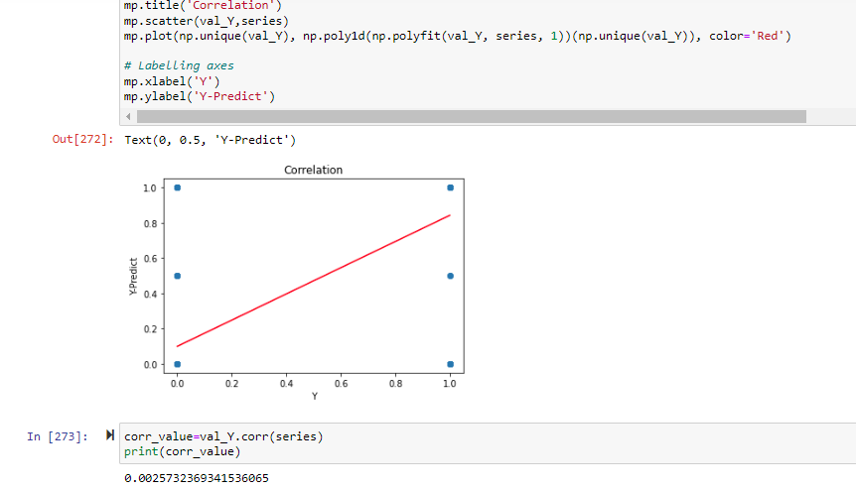
ML Models
Correlation Model

Slide 10

Recommendations
Target market strategies to older customers
Dealers can also tailor their commercials to appeal to the middle class
Find creative means to get customers affordable deals
Appeal more to female customer base

Slide 11
Next Steps
More data needed to improve ML
Constantly update customer data
Better ML models that are more accurate

